Slide 1
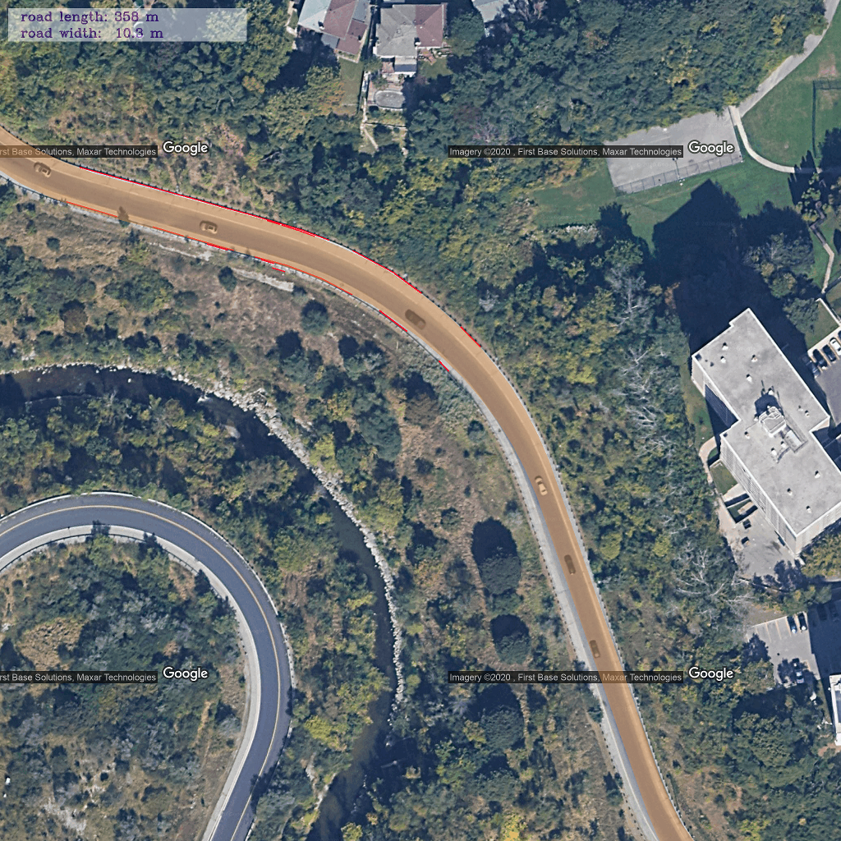
Curve ramp
Image size: 2048*2048

Slide 2
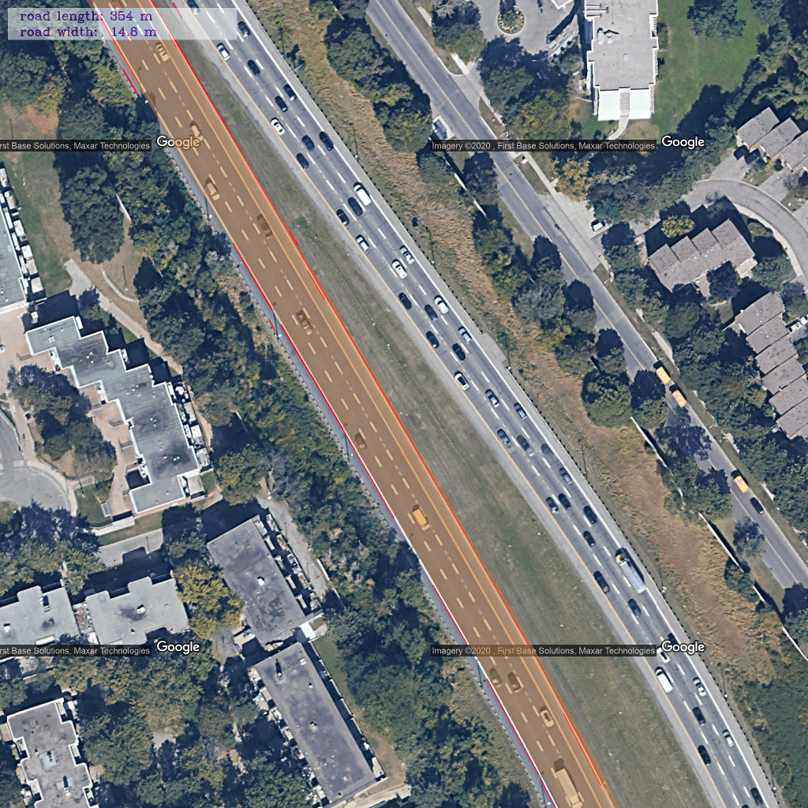
Highway (one way)

Slide 3
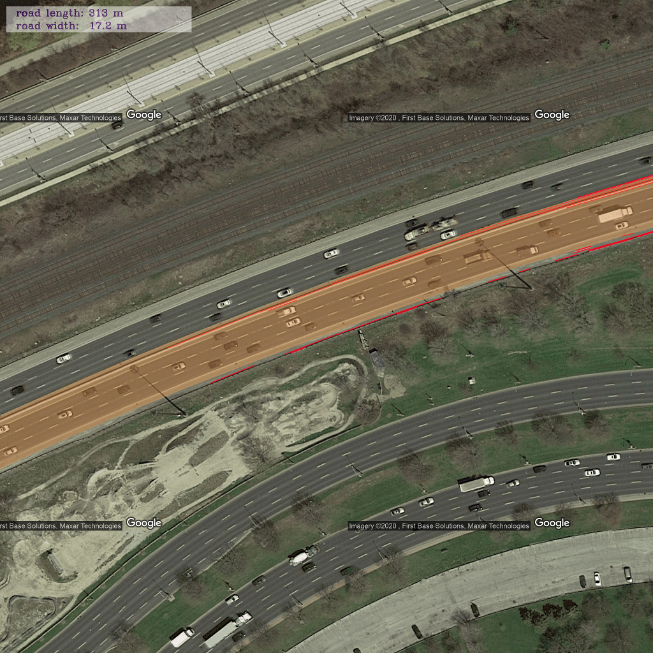
Highway (two-way)

Slide 4
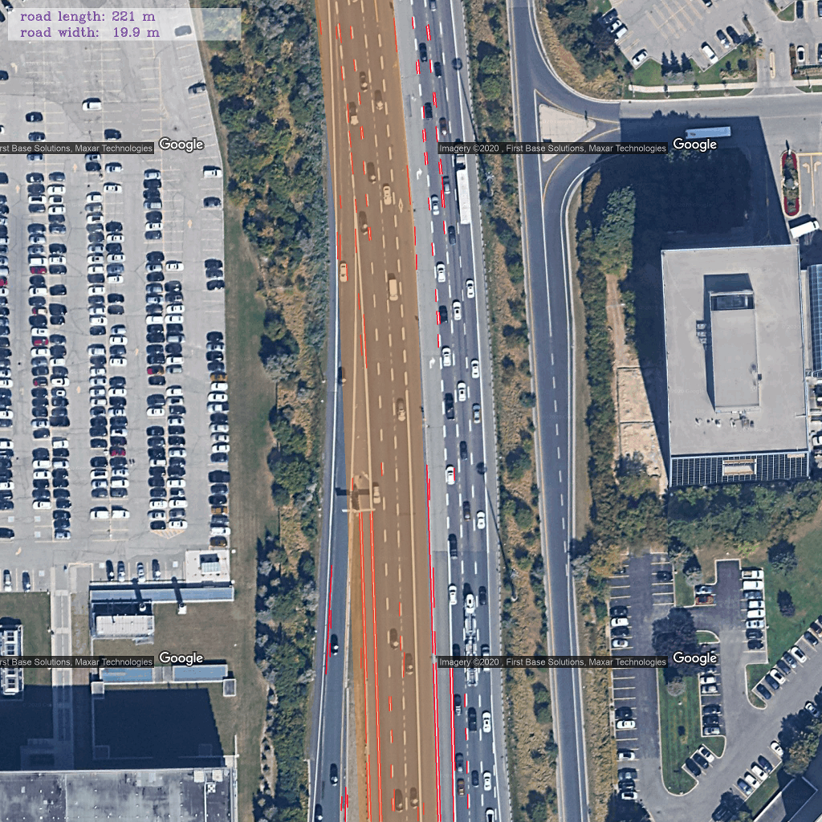
Highway (two-way)

Slide 5
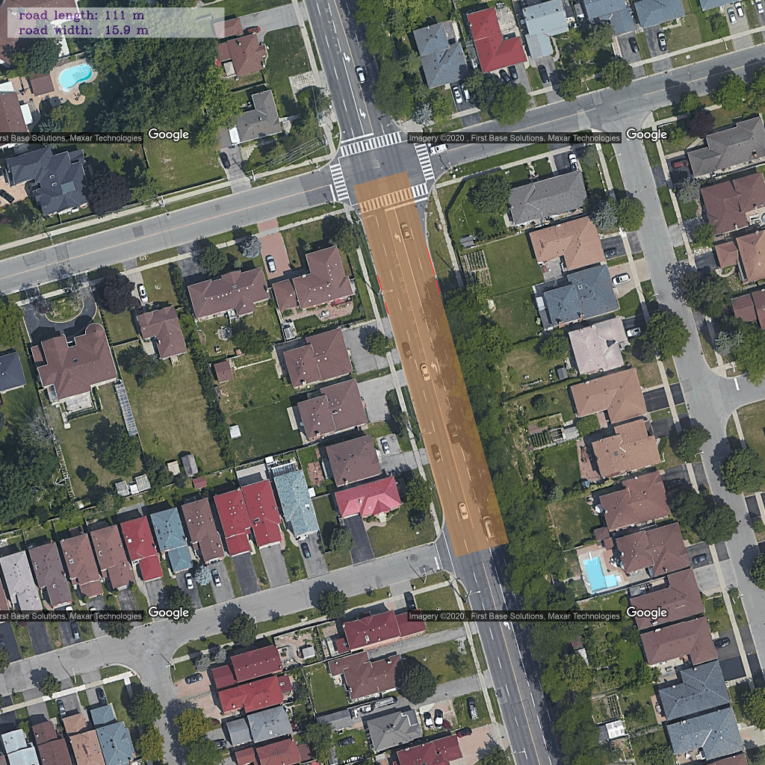
Main road

Slide 6
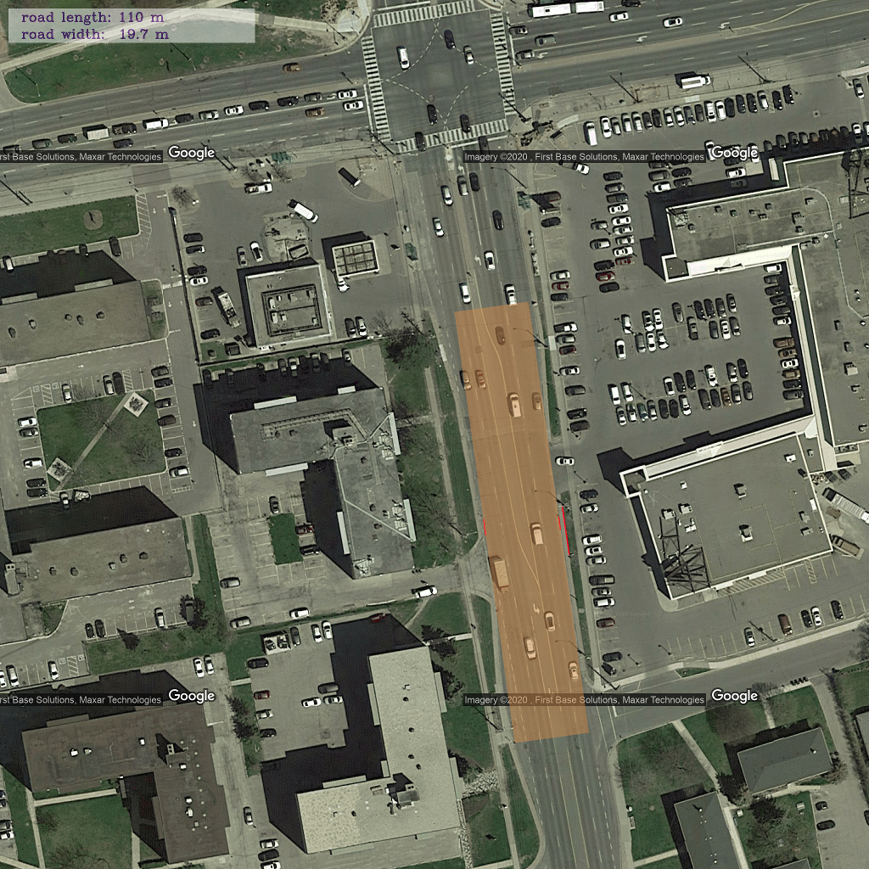
Problems:
depends on shapefile
a. too short to cover roads

Slide 7
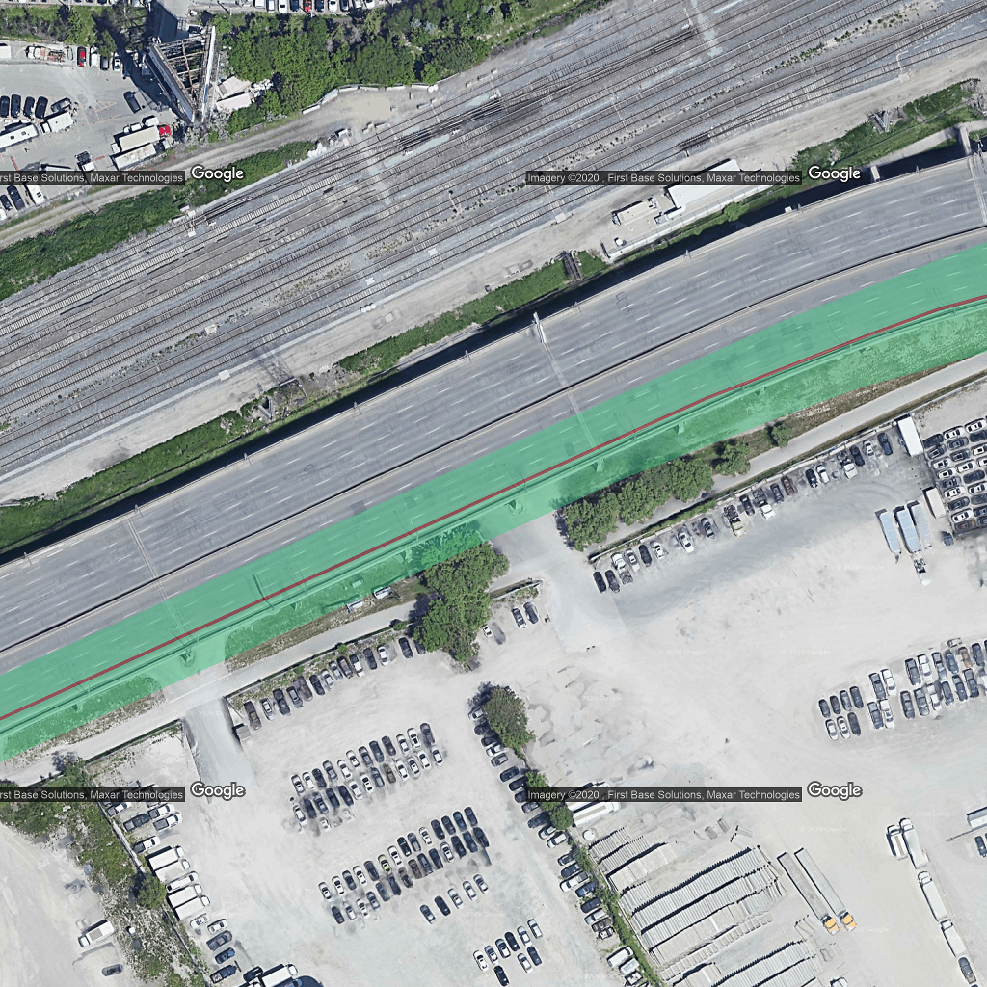
Problems:
depends on shapefile
a. too short to cover roads
b. not real center

Slide 8
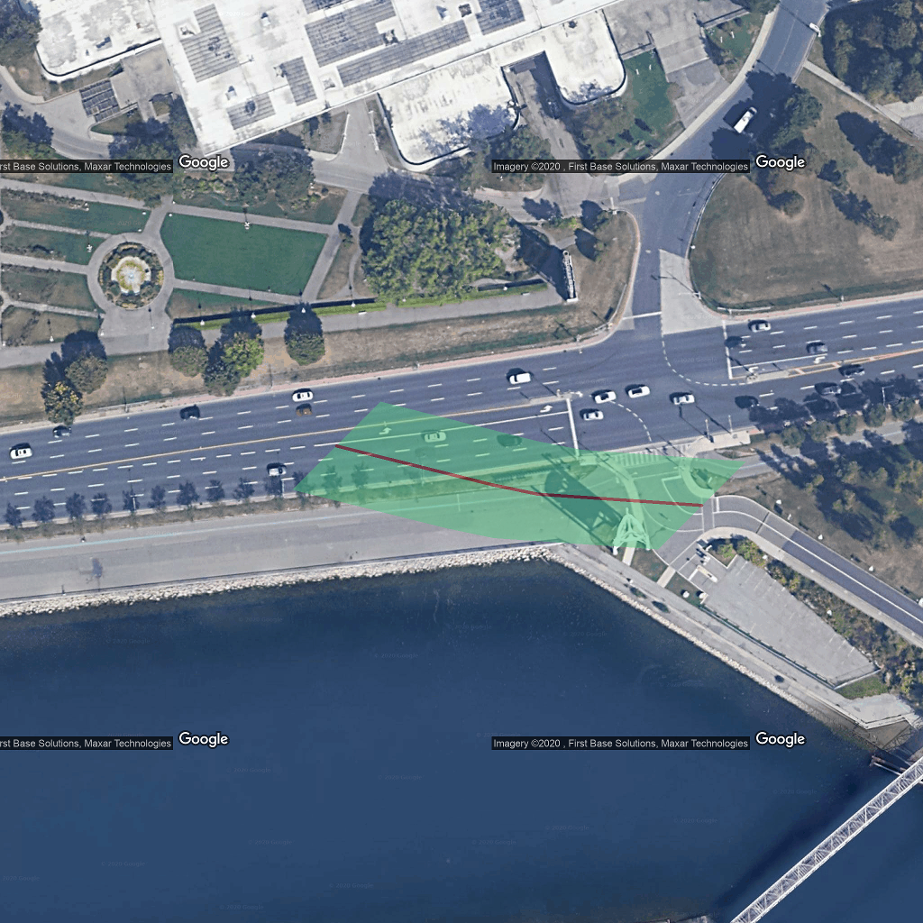
Problems:
depends on shapefile
a. too short to cover roads
b. not real center
c. located to wrong line

Slide 9
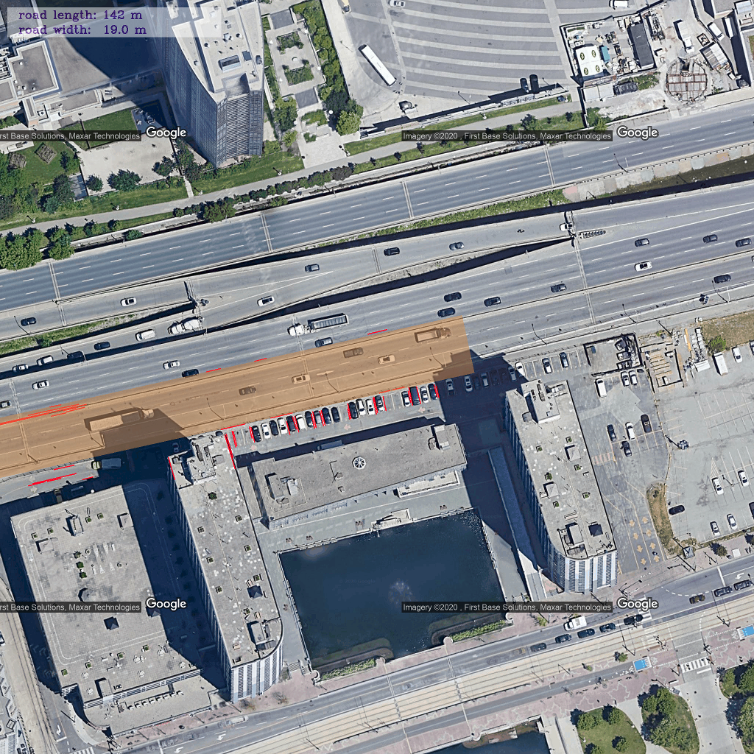
TODO:
Use more information from shapefile:
1. median (separating traffic)
2. all segments in the image
Detect cars covered in the mask

